Slide 1

APPLICATION OF RECYCLED MATERIALS IN ROAD CONSTRUCTION
GUIDED BY :
DR. MONALISA PATRA
PRESENTED BY :
Abhisek Pattnaik 1901227044
Pratik Kumar Sahoo 1901227030
Abhijeet Nayak 1901227009
Jeebitesh Behera 1901227023
Soyam Prasad Samal 1901227046
Sunil Kumar Malik CVE20L18

Slide 2
INTRODUCTION
As the world population grows, so do the amount and type of waste being generated. Many of the wastes produced today will remain in the environment.
According to NITI Aayog(2021), urban India generates between 1.3L to 1.5L metric tonne of municipal solid waste every day except biodegradable waste. Which is 50 million MT per year.
If the proper utilization of these wastes can be done it can substitute natural construction materials and drastically reduce the quantity of waste.
Some of the widely used recycled materials in road construction are reclaimed asphalt , plastic wastes , glass wastes, recycled concrete aggregate, mine waste, coal powder, fly ash, steel slag etc.
https://www.niti.gov.in/sites/default/files/2021-12/Waste-Wise-Cities.pdf

Slide 3
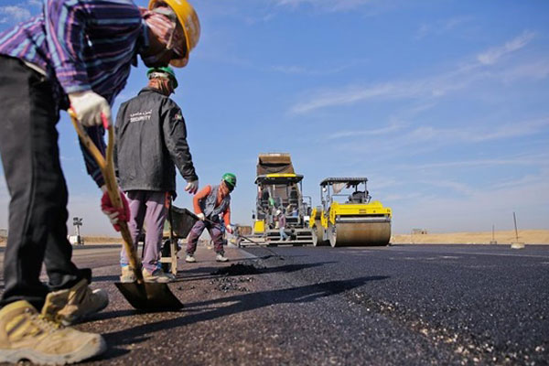
OBJECTIVE
Investigation of waste materials or byproduct or recycled materials.
To test various properties of materials in the lab to be used for road construction.
Analysis of the test results to evaluate suitability of recycled materials for road construction.

Slide 4
METHODOLOGY
Tests to be performed
Materials Collection
Normal Aggregates
Quarry waste(Fine Aggregates)
Waste glass
Concrete waste
Reclaimed asphalt
Iron slag
Bitumen
Waste Plastic
Specific Gravity Test
Impact Value test
Los Angeles Abrasion value test
Water absorption test
Marshall stability test
Softening Point

Slide 5
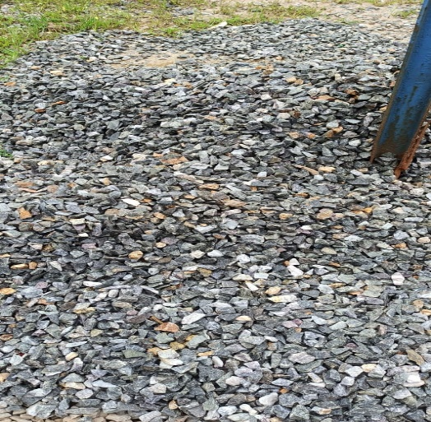
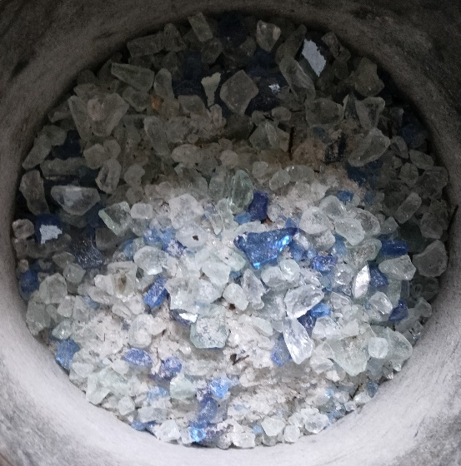
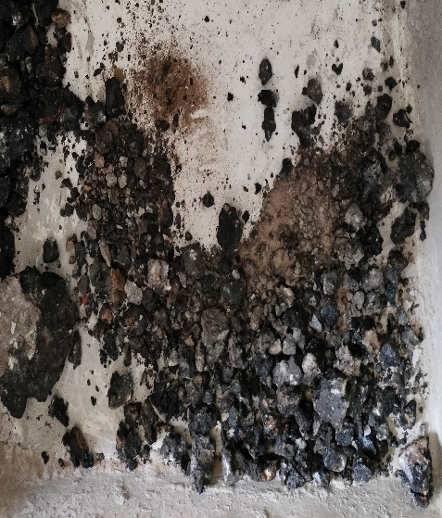
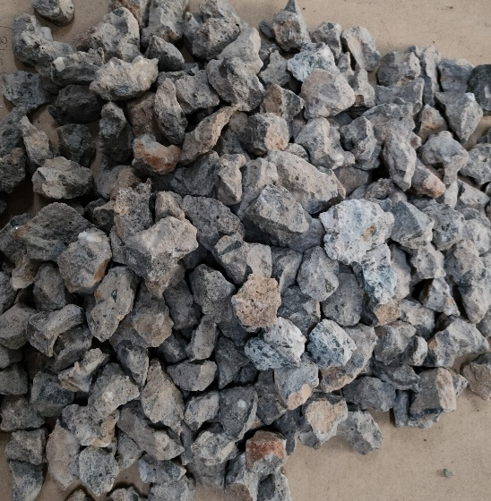
Materials Collection:-
Normal Aggregates
Waste Glass
Reclaimed Asphalt
Recycled Concrete Aggregate

Slide 6
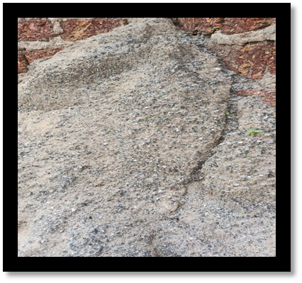
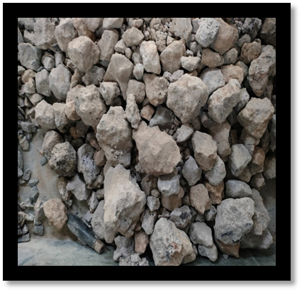
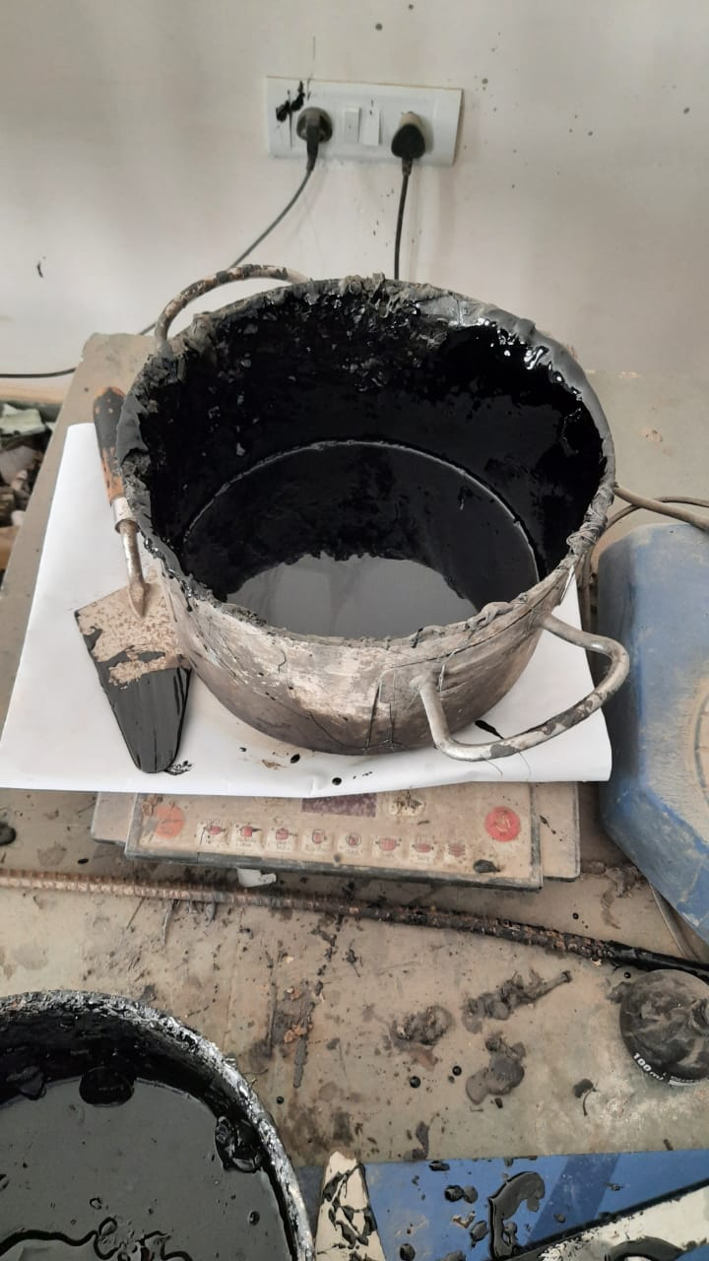
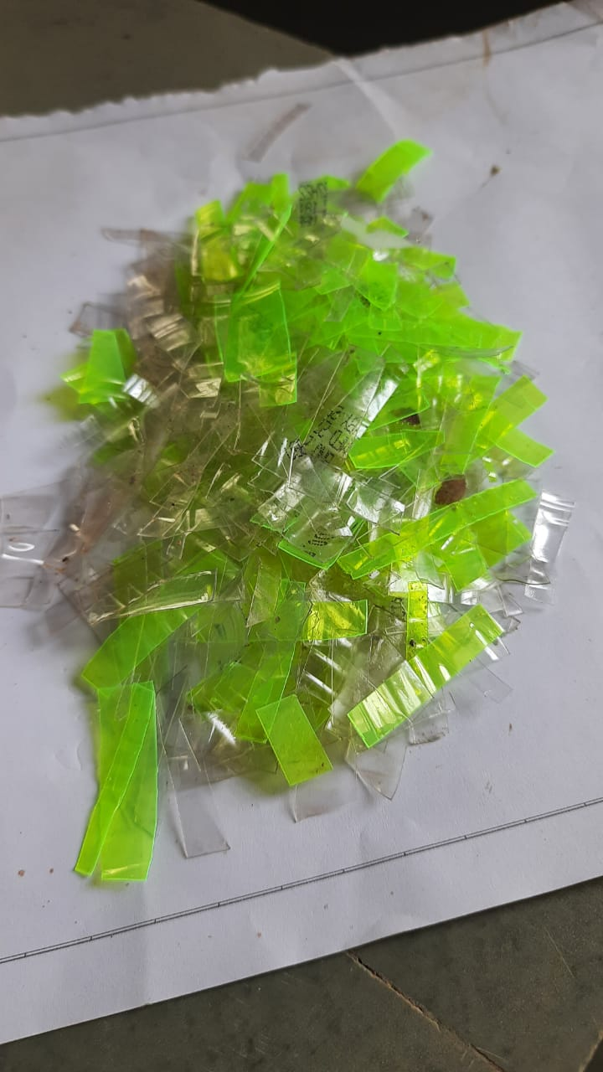
Stone Crusher Waste
Iron Slag
Bituminous
Waste Plastic

Slide 7
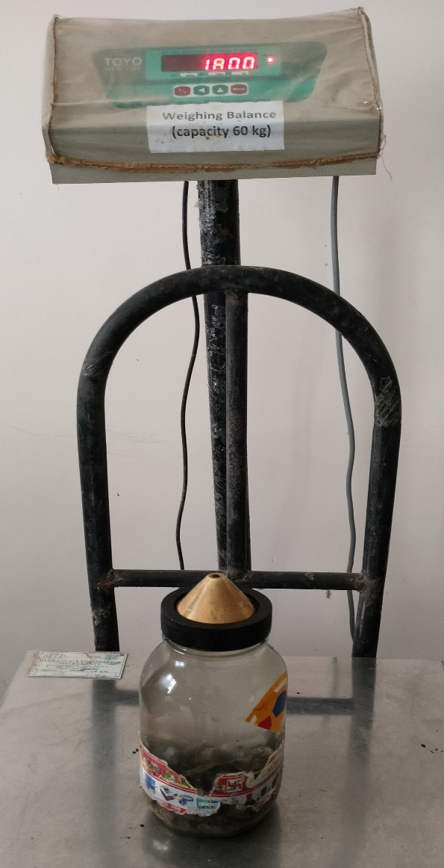
Tests Performed On Aggregates
1.Specific gravity Test :(Using Pycnometer)
The specific gravity of an aggregate is considered to be a measure of strength or quality of the material.
The specific gravity is defined as the ratio of the mass of a given volume of the aggregate to the mass of an equal volume of water.
Aggregates having low specific gravity are generally weaker than those with high specific gravity.
The specific gravity of aggregates normally used in construction ranges from about 2.5 to 3.0. (As per IS 2386-3 (1963))

Slide 8
Result of Specific Gravity
Sample No | W1 (gm) | W2 (gm) | W3 (gm) | W4 (gm) | SPECIFIC GRAVITY
1 | 510 | 1504 | 1100 | 1882 | 2.783
2 | 510 | 1508 | 1064 | 1854 | 2.666
3 | 510 | 1506 | 1070 | 1860 | 2.718
Average = 2.722
Sample size : 20mm sieve passed and 12.5mm sieve retained
W1 : Mass of clean dried pycnometer
W2 : Mass of pycnometer filled with distilled water
W3 : Mass of pycnometer with aggregate (1/3rd)
W4 : Mass of pycnometer with aggregate & distilled water

Slide 9
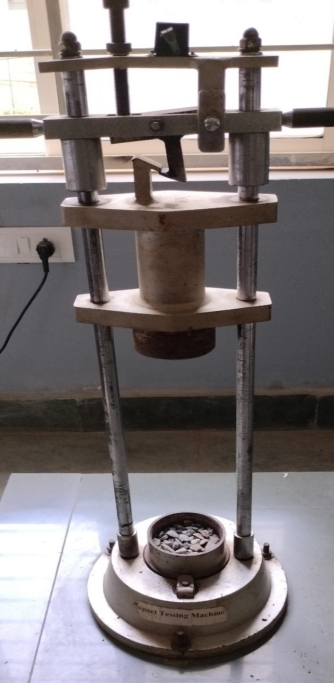
2. Aggregate Impact Value
It is the ability of aggregate that resist sudden impact or shock load on it.
The characteristics of any material to resist sudden impact is toughness.
The impact load can break aggregate into smaller pieces which results in the failure of roads and pavements.
The need of impact test is used to measure the toughness of aggregate which is nothing but the ability of aggregate to resist the sudden loading or impact loading.
The quality of aggregate in impact test is based upon IS2386 Part 4.

Slide 10
Result of Impact Value Test
Sample No | Weight of measuring cylinder (A) | Wt. of measuring cylinder + aggregate(B) | Weight of aggregate (W1) (B-A) | Wt. of aggregate passed 2.36 mm sieve(W2) | Impact value (%) W2/W1 *100
1. | 880 | 1226 | 346 | 50 | 14.45
2. | 880 | 1214 | 334 | 56 | 16.76
3. | 880 | 1218 | 337 | 54 | 16.02
Average = 15.74%
All units are in gm.
Sample 1 & 2 : 12.5mm sieve passed and 10mm sieve retained
Aggregate Impact value | Classification
<10% | Exceptionally Strong
10-20% | Strong
20-30% | Satisfactory for road surfacing
>30% | Weak for road surfacing

Slide 11
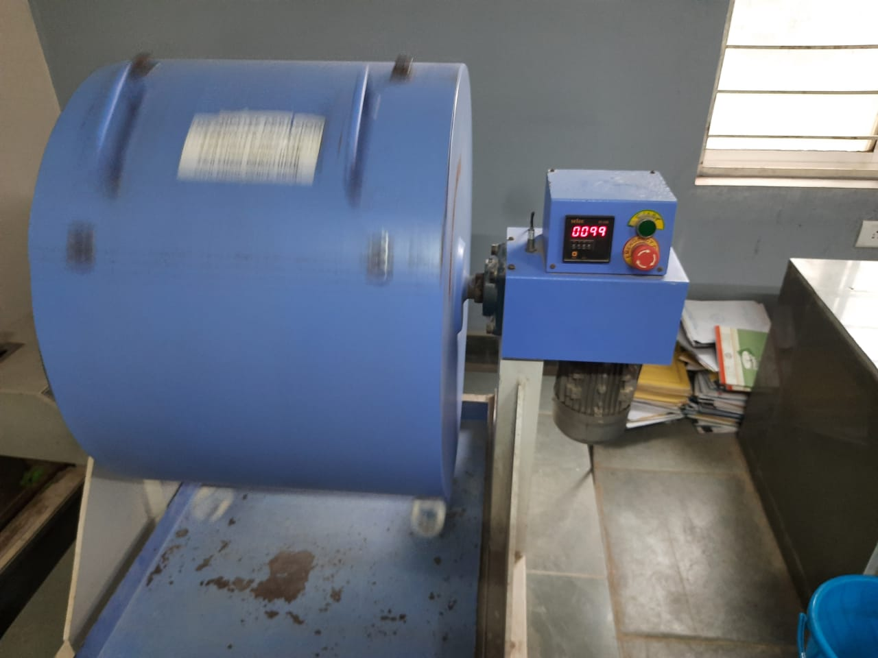
3. Los Angeles Abrasion value of aggregates
Abrasion is a measure of resistance to hardness and abrasion resistance such as crushing.
When vehicles travel on the road, the soil particles present between the tires of the vehicle & the road surface creates abrasion effect on aggregates.
Aggregates used in road construction must be hard enough to resist abrasion.
The working principle of Los Angeles abrasion test is to find the percentage wear due to the relative rubbing action between the aggregate and steel balls used as abrasive charge.
Los Angeles Abrasion Machine

Slide 12
The suitability of aggregates for different road constructions can be judged as per IRC specifications as given below.
Sl No. | Types of Pavement | Max. permissible abrasion value In %
1. | WBM sub base course | 60
2. | WBM with bituminous surfacing | 50
3. | Bituminous bound macadam | 50
4. | WBM surfacing course | 40
5. | Bituminous penetration macadam | 40
6. | Bituminous surface dressing, cement concrete surface course | 35
7. | Bituminous concrete surface course | 30

Slide 13
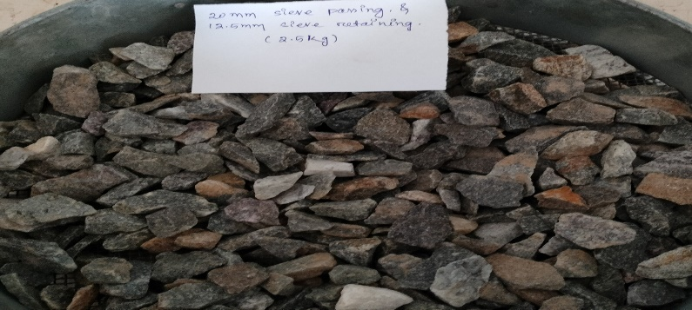
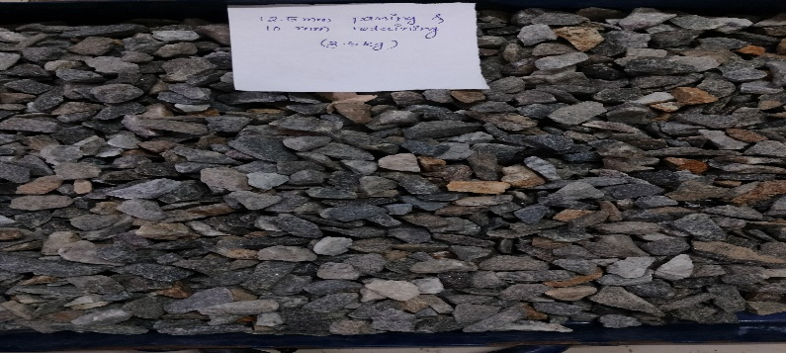
Result of Abrasion Test
Wt. of sample (W1 gm) | 5000 | 5000 | 5000
Wt. of sample after abrasion & passed 1.7mm sieve (W2 gm) | 3550 | 3568 | 3562
% wear (W1-W2)/W1 * 100 | 29% | 28.64% | 28.76%
Average = 28.8%
The value we got was 28.8% which indicate that it was only suitable for Bituminous concrete surface course .(IS 2386-5)
20mm passed 12.5mm retained
12.5mm passed 10mm retained

Slide 14
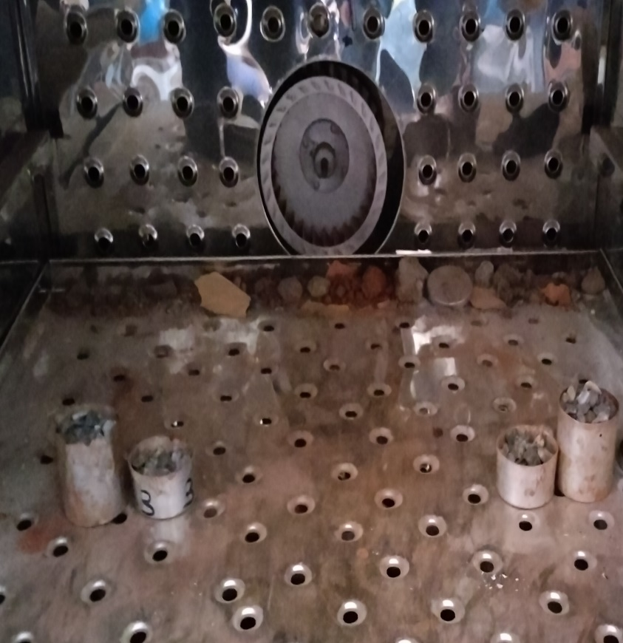
4. Water Absorption Test :-
Water absorption gives an idea on the internal structure of aggregate.
Aggregates having more absorption are more porous in nature and are generally considered unsuitable.
The water absorption of aggregate ranges from 0.1 to 2% and not more than that. (IS 2386 Part 3)
Materials kept in oven

Slide 15
Result of water absorption test
Sample No | Wt. of oven dried sample W1 | Wt. of saturated sample W2 | Wt. of water absorbed (W3=W2-W1) | % of Water Absorption (W3/W1*100)
1 | 200 | 201.3 | 1.3 | 0.65%
2 | 200 | 200.9 | 0.9 | 0.45%
3 | 200 | 201 | 1 | 0.5%
Average = 0.53%
All units are in gram.
Sample 1 & 2 : Passed through 10mm sieve.
The value obtained of both the sample is greater than 0.1 & less than 2%

Slide 16
5.Flakiness Index test of aggregate
It is the percentage by particles whose least thickness is less than 0.6 times of their mean thickness.
The Flakiness test is not applicable to sizes smaller than 6.3mm.
Passing through I.S Sieve (mm) | Retained on I.S Sieve (mm) | Wt. of fraction consisting of at least 200 pieces (gm) | Wt. of aggregate in each fraction passing on thickness gauge (gm)
25 | 20 | 3160 | 746
20 | 16 | 2010 | 312
16 | 12.5 | 1030 | 233
12.5 | 10 | 554 | 134
W = 6754gm
W = 1425gm
Flakiness Index = (w/W)*100 = 21.09%
The value we got was 21.09% which indicate that it was only suitable for Bituminous penetration macadam, Bituminous surface dressing. (IS 2386-5)

Slide 17
6.Elongation Index test of Aggregate
The elongation index of an aggregate is the percentage by weight of particles whose greatest length is greater than 1.8 times their mean length.
The elongation test is not applicable to sizes smaller than 6.3mm.
Passing through I.S Sieve (mm) | Retained on I.S Sieve (mm) | Wt. of fraction consisting of at least 200 pieces (gm) | Wt. of aggregate in each fraction retained on length gauge (gm)
25 | 20 | 3160 | 627
20 | 16 | 2010 | 120
16 | 12.5 | 1030 | 336
12.5 | 10 | 554 | 55
Total = 6754 gm 1138 gm
Elongation Index = (w/W)*100 = 16.84%
The combined value of flaky & elongation index is
16.84+21.09= 37.94%

Slide 18
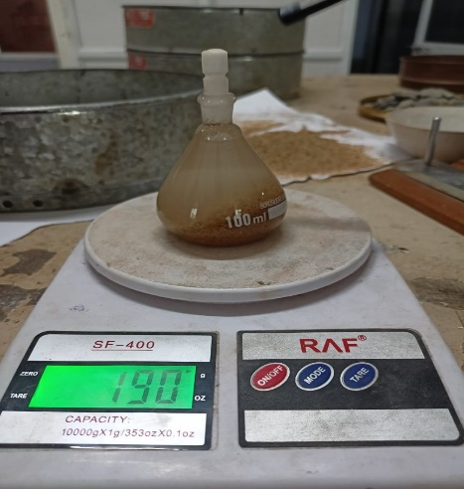
7.Specific Gravity Test: (Sand) Using Density Bottle
Sample | W1(gm) | W2(gm) | W3(gm) | W4(gm) | Specific Gravity
1 | 47 | 149 | 113 | 190 | 2.64
2 | 45 | 148 | 89 | 176 | 2.75
3 | 47 | 149 | 111 | 191 | 2.90
Average = 2.76
W1 : Mass of clean dried density bottle
W2 : Mass of density bottle filled with distilled water
W3 : Mass of density bottle with Sand (1/3rd)
W4 : Mass of density bottle with Sand & distilled water
*The size of sand is retained on 1.5 mm sieve.
Sand

Slide 19
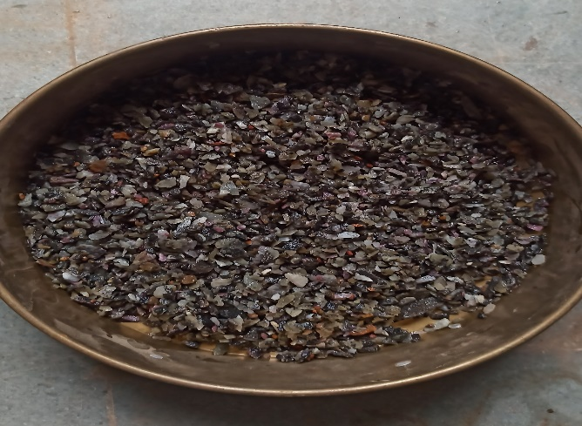
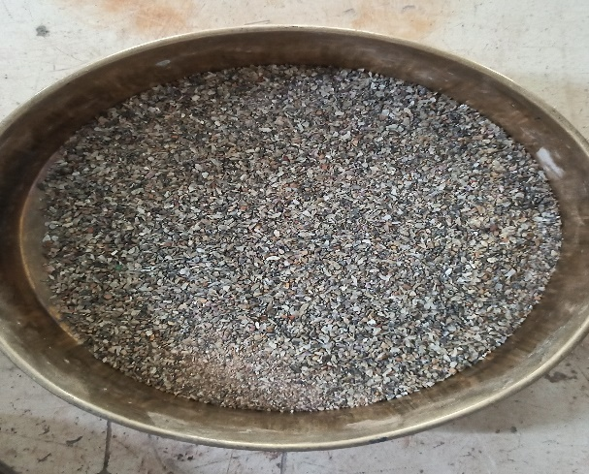
Test Performed On Quarry Waste
1.Specific Gravity Test (Pycnometer)
The specific gravity is defined as the ratio of the mass of a given volume of the aggregate to the mass of an equal volume of water.
The specific gravity of all the crusher samples is lies in between 2.5 to 3 which fulfill the sand requirement.(IS 2386 part 3)
Materials retaining on 1.7 mm sieve
Materials retaining on 150 micron sieve

Slide 20
Result of Specific Gravity
Sample No | W1 (gm) | W2 (gm) | W3 (gm) | W4 (gm) | SPECIFIC GRAVITY
1 | 588 | 1559 | 1066 | 1871 | 2.87
2 | 588 | 1565 | 1068 | 1873 | 2.79
3 | 588 | 1566 | 1064 | 1869 | 2.75
Average = 2.80
W1 : Mass of clean dried pycnometer
W2 : Mass of pycnometer filled with distilled water
W3 : Mass of pycnometer with quarry waste (1/3rd)
W4 : Mass of pycnometer with quarry waste & distilled water

Slide 21
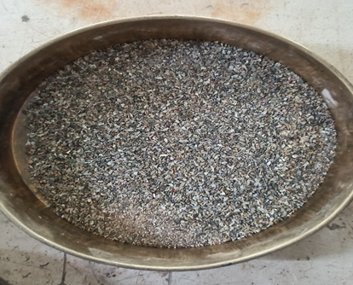
Using Density Bottle :-
For the material size i.e. retained on 150 micron sieve, we performed the specific gravity test using density bottle.
We use this material as a substitute of filler material.
Sample Number | W1 (gm) | W2 (gm) | W3 (gm) | W4 (gm) | Specific Gravity
1 | 44 | 148 | 110 | 190 | 2.75
2 | 44 | 148 | 109 | 189 | 2.70
3 | 44 | 146 | 112 | 190 | 2.83
Avg.=2.76
W1 : Mass of clean dried pycnometer
W2 : Mass of pycnometer filled with distilled water
W3 : Mass of pycnometer with quarry waste (1/3rd)
W4 : Mass of pycnometer with quarry waste & distilled water

Slide 22

2. Water Absorption Test :-
Water absorption gives an idea on the internal structure of aggregate.
Aggregates having more absorption are more porous in nature and are generally considered unsuitable.
The water absorption of aggregate ranges from 0.1 to 2% and not more than that. (IS 2386 Part 3)
Sample Size :Retained on 1.7 mm sieve

Slide 23
Observation & Calculation :-
Sample No | Wt. of oven dried sample (W1) | Wt. of saturated sample (W2) | Wt. of water absorbed (W3=W2-W1) | % of Water Absorption (W3/W1*100)
1 | 200gm | 205gm | 5gm | 2.5%
2 | 200gm | 203.5gm | 3.5gm | 1.75%
Average= 2.13%

Slide 24
Test Performed on Waste Materials A. Specific Gravity Test :
1.Crushed Glass (Density Bottle)
Sample | W1(gm) | W2(gm) | W3(gm) | W4(gm) | Specific Gravity
1 | 45 | 148 | 88 | 175 | 2.68
2 | 45 | 148 | 87 | 174 | 2.62
3 | 45 | 148 | 89 | 176 | 2.75
Average= 2.68
Sample Size : Retained on 1.7mm sieve
W1 : Weight of clean dried density bottle
W2 : Weight of density bottle filled with distilled water
W3 : Weight of pycnometer with crushed glass(1/3rd)
W4 : Weight of pycnometer with crushed glass & distilled water

Slide 25
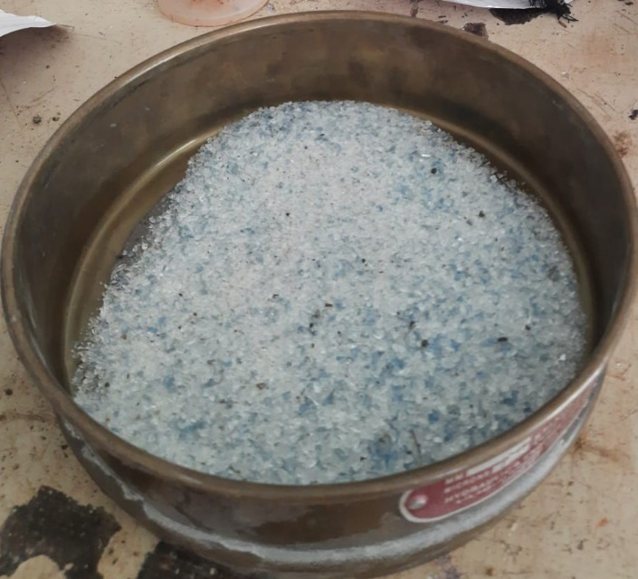
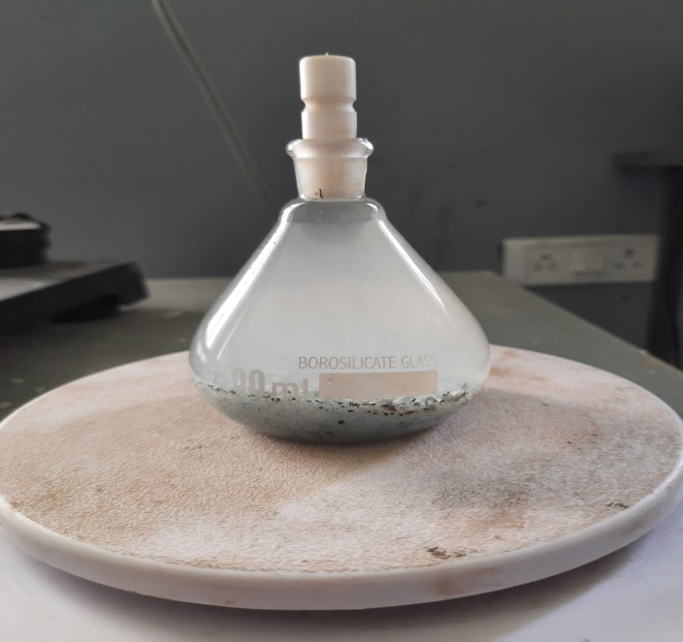
Crushed Glass retained on 1.5mm sieve
Crushed Glass & Density Bottle

Slide 26
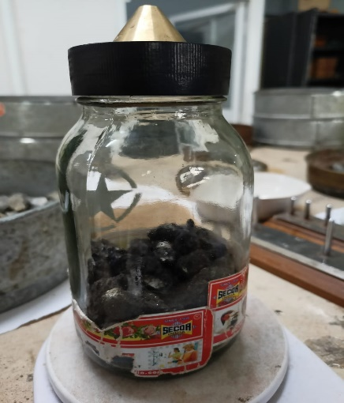
Specific Gravity Test:
2. Reclaimed Asphalt (Pycnometer)
Sample | W1 (gm) | W2 (gm) | W3 (gm) | W4 (gm) | Specific Gravity
1 | 587 | 1583 | 988 | 1821 | 2.46
2 | 587 | 1584 | 985 | 1820 | 2.47
3 | 587 | 1583 | 987 | 1823 | 2.57
Sample | W1 (gm) | W2 (gm) | W3 (gm) | W4 (gm) | Specific Gravity
1 | 587 | 1583 | 988 | 1821 | 2.46
2 | 587 | 1584 | 985 | 1820 | 2.47
3 | 587 | 1583 | 987 | 1823 | 2.57
Sample size : 20 mm passed and 12.5 retained
W1 : Mass of clean dried pycnometer
W2 : Mass of pycnometer filled with distilled water
W3 : Mass of pycnometer with bitumen waste (1/3rd)
W4 : Mass of pycnometer with bitumen waste & distilled water
Average = 2.5
Reclaimed Asphalt

Slide 27
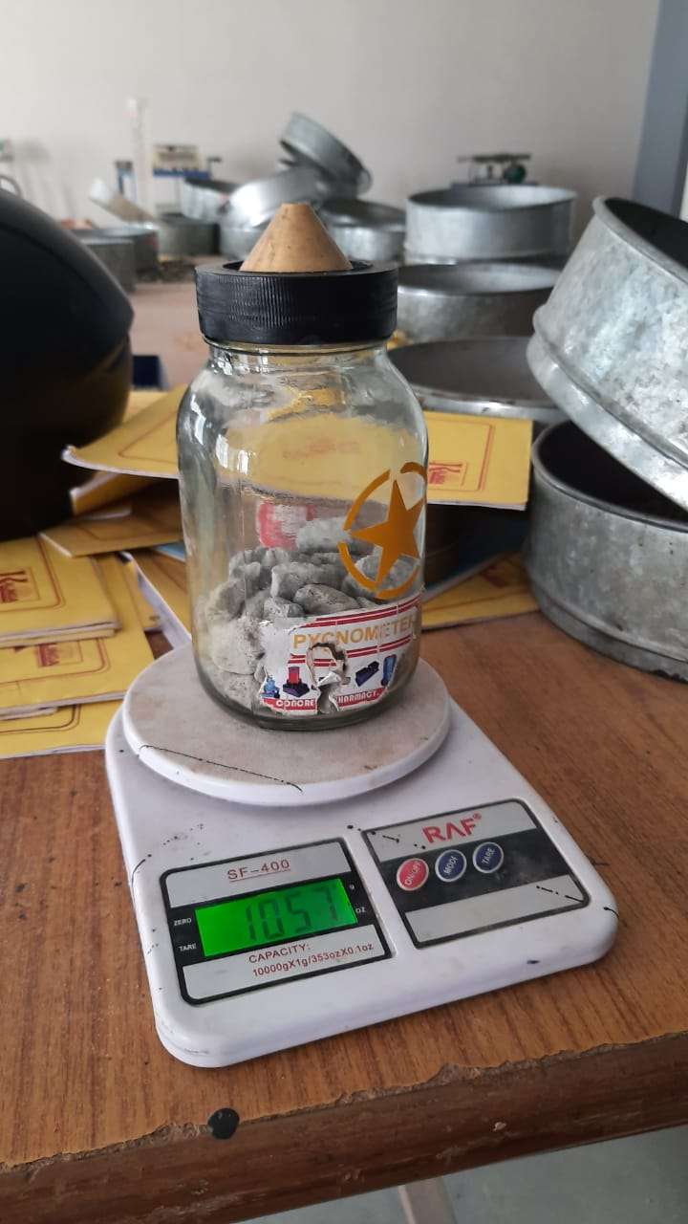
Specific Gravity Test : 3. Waste Concrete (Using Pycnometer)
Sample | W1 (gm) | W2 (gm) | W3 (gm) | W4 (gm) | Specific Gravity
1 | 508 | 1544 | 889 | 1579 | 1.01
2 | 508 | 1543 | 894 | 1578 | 1.09
3 | 508 | 1546 | 891 | 1581 | 1.10
Average=1.06
Sample size : 20 mm passed and 12.5 retained
W1 : Mass of clean dried Pycnometer
W2 : Mass of Pycnometer filled with distilled water
W3 : Mass of Pycnometer with waste concrete (1/3rd)
W4 : Mass of Pycnometer with waste concrete & distilled water

Slide 28
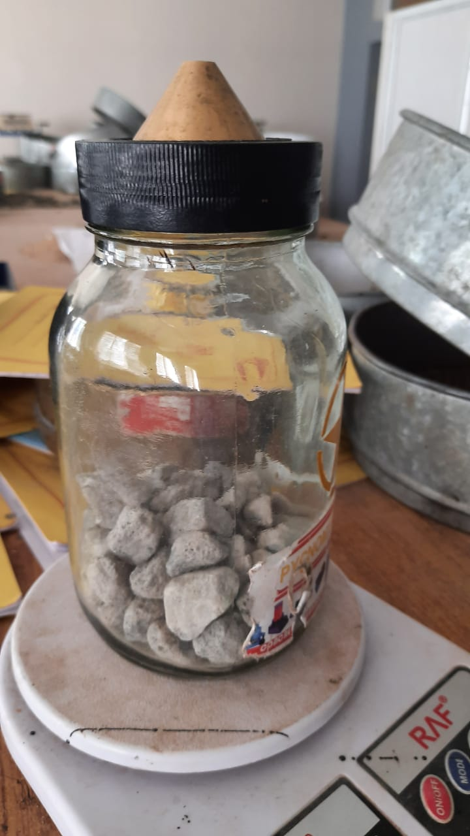
Specific Gravity Test : 4. Iron Slag : (Using Pycnometer)
Sample | W1 (gm) | W2 (gm) | W3 (gm) | W4 (gm) | Specific Gravity
1 | 587 | 1582 | 1103 | 1946 | 3.39
2 | 587 | 1580 | 1100 | 1945 | 3.46
3 | 587 | 1581 | 1101 | 1944 | 3.40
Average=3.41
Sample size : 20 mm passed and 12.5 retained
W1 : Mass of clean dried Pycnometer
W2 : Mass of Pycnometer filled with distilled water
W3 : Mass of Pycnometer with iron slag (1/3rd)
W4 : Mass of Pycnometer with iron slag & distilled water

Slide 29
(B). Impact Value test 1.Waste Concrete :-
Sample Size : 12.5 mm passed & 10mm retained
Sample | Weight of measuring cylinder (A) | Wt. of measuring cylinder + aggregate (B) | Weight of aggregate (W1) (B-A) | Wt. of aggregate passed 2.36mm sieve (W2) | Impact value (%) W2/W1 *100
1 | 880 | 1157 | 277 | 84 | 30.32
2 | 880 | 1158 | 278 | 79 | 28.41
3 | 880 | 1156 | 276 | 82 | 29.71
Average = 29.48%
The impact value of above sample was satisfactory for road surfacing .

Slide 30
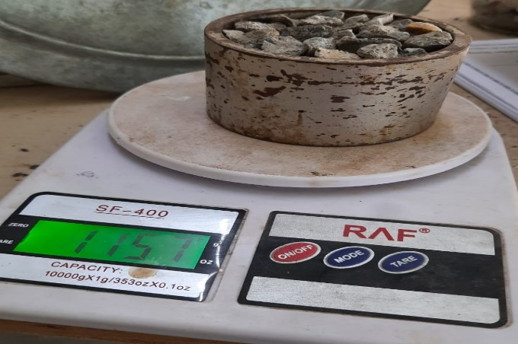
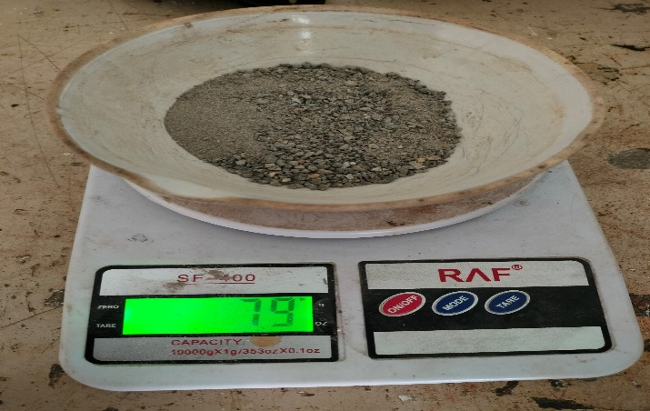
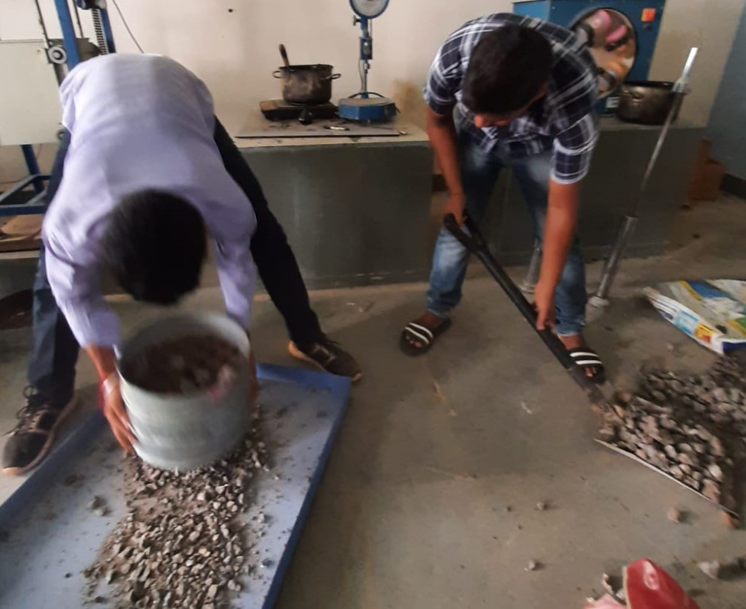
Wt. of waste concrete in cylindrical measure
Wt. of concrete passed by 2.36mm sieve
Sieve of waste Concrete

Slide 31
Impact Value test : 2. Reclaimed Asphalt :-
Sample Size : 12.5 passed & 10mm retained
Sample | Weight of measuring cylinder (A) | Wt. of measuring cylinder + aggregate (B) | Weight of aggregate (W1) (B-A) | Wt. of aggregate passed 2.36mm sieve (W2) | Impact value (%) W2/W1 *100
1 | 880 | 1193 | 313 | 44 | 14.06
2 | 880 | 1176 | 296 | 50 | 16.91
3 | 880 | 1187 | 307 | 43 | 14.00
Average = 15.01%
So the above aggregate had strong impact value.

Slide 32
Impact Value Test : 3. Iron Slag :-
Sample Size : 12.5 mm sieve passed & 10 mm sieve retained
Sample | Weight of measuring cylinder (A) | Wt. of measuring cylinder + aggregate (B) | Weight of aggregate (W1) (B-A) | Wt. of aggregate passed 2.36mm sieve (W2) | Impact value (%) W2/W1 *100
1 | 880 | 1264 | 384 | 35 | 9.11
2 | 880 | 1257 | 377 | 31 | 8.22
3 | 880 | 1266 | 386 | 37 | 9.58
Average = 8.97
So the above aggregate had exceptionally strong impact value.

Slide 33
(C). Los Angeles Abrasion Test :- 1. Waste Concrete :-
Abrasion is a measure of resistance to hardness and abrasion resistance such as crushing.
The suitability of aggregates for different road constructions can be judged as per IRC specifications as given below.
Sl No. | Types of Pavement | Max. permissible abrasion value In %
1. | WBM sub base course | 60
2. | WBM with bituminous surfacing | 50
3. | Bituminous bound macadam | 50
4. | WBM surfacing course | 40
5. | Bituminous penetration macadam | 40
6. | Bituminous surface dressing, cement concrete surface course | 35
7. | Bituminous concrete surface course | 30

Slide 34
Results of Abrasion Test :-
Wt. of sample (W1 gm) | 5000 | 5000 | 5000
Wt. of sample after abrasion & passed 1.7mm sieve (W2 gm) | 1460 | 1465 | 1461
% wear (W1-W2)/W1 * 100 | 29.2 | 29.3 | 29.2
Average =29.23%
The value we got was 29.23% which indicate that it was only suitable for Bituminous concrete surface course .(IS 2386-5)

Slide 35
(D). Water Absorption Test :- 1. Waste Concrete :-
Water absorption gives an idea on the internal structure of aggregate.
Aggregates having more absorption are more porous in nature and are generally considered unsuitable.
The water absorption of aggregate ranges from 0.1 to 2% and not more than that. (IS 2386 Part 3)

Slide 36
Calculation & Observation :-
Sample No | Wt. of oven dried sample W1(gm) | Wt. of saturated sample W2(gm) | Wt. of water absorbed (W3=W2-W1) (gm) | % of Water Absorption (W3/W1*100)
1 | 196 | 204 | 8 | 4.08%
2 | 199 | 203 | 4 | 2.01%
3 | 198 | 204 | 6 | 3.03%
Average = 3.04%
The value obtained of both the sample is greater than 2% & is not in the permissible limit.

Slide 37
Tests Performed on Bituminous :- (A). Specific Gravity Test :-
The specific gravity is defined by ISI as the ratio of the mass of a given volume of the bituminous material to the mass of an equal volume of water, the temperature of both being specified at 27°C±0.1°C.
The specific gravity is greatly influenced by the chemical composition of binder.
Increased amount of aromatic type compounds cause an increase in the specific gravity.

Slide 38
Sample | W1 (gm) | W2 (gm) | W3 (gm) | W4 (gm) | Specific Gravity
1 | 46 | 146 | 104 | 148 | 1.03
2 | 46 | 144 | 105 | 149 | 1.09
3 | 46 | 145 | 103 | 148 | 1.05
Average=1.05
W₁ = Mass of clean and dried density bottle
W₂ = Mass of density bottle with distilled water
W₃= Mass of density bottle with Bituminous material
W₄ = Mass of density bottle with Bituminous material and distilled water

Slide 39
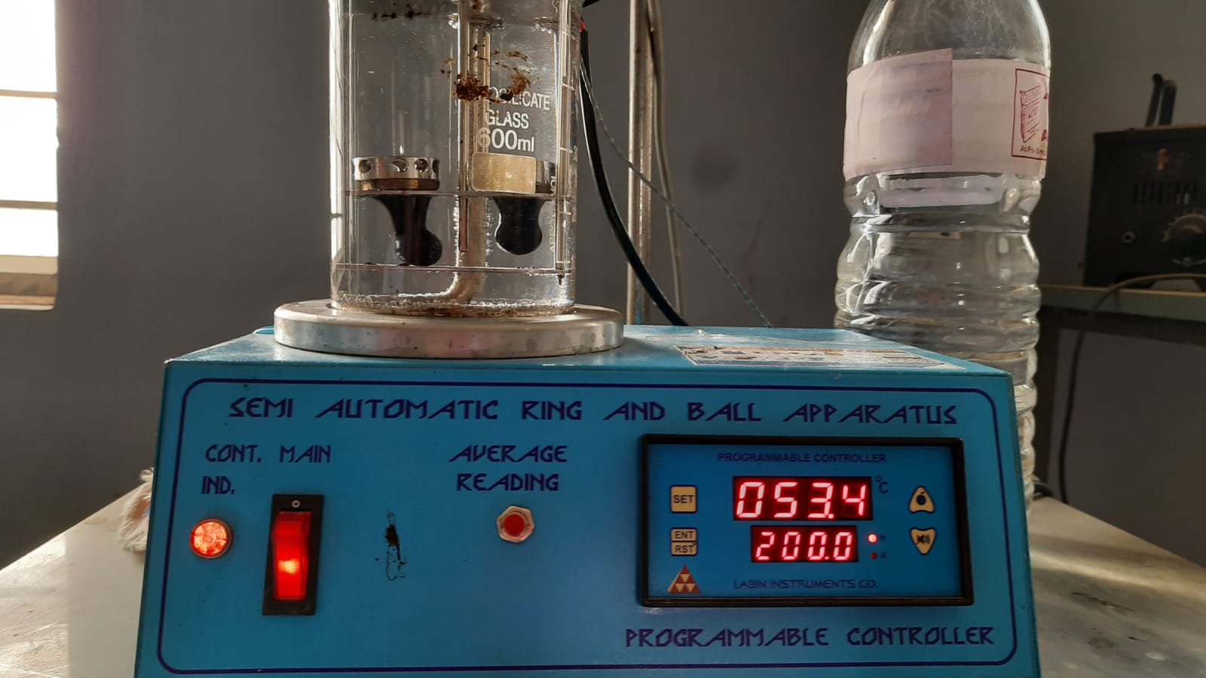
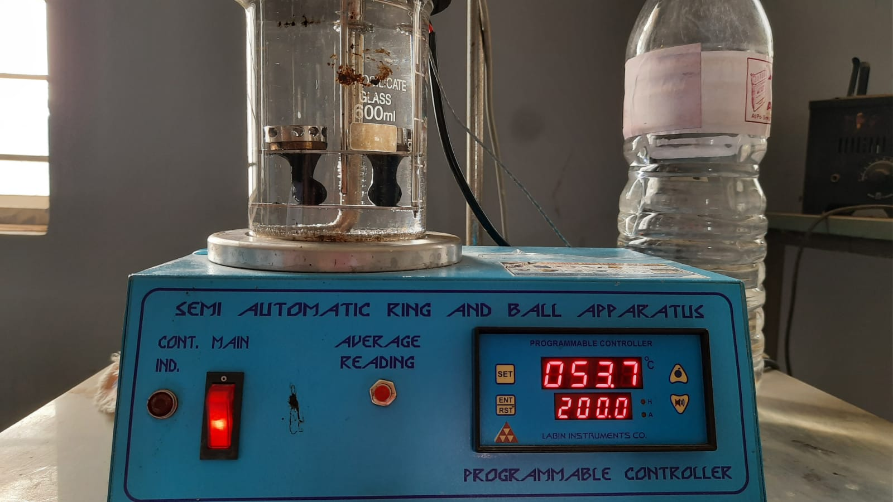
(B). Softening Point Test :-
Bitumen does not suddenly change from solid to liquid state, but as the temp increase, it gradually becomes soften until it flows rapidly.
The softening point of bitumen is the temp at which the substance attains particular degree of softening under specified condition of test.

Slide 40
Observation & Calculation :-
Test Property | Trial-1
Temperature (in ºcelsious)at which I ball touches the bottom plate | 53.4
Temperature (in ºcelsious)at which II ball touches the bottom plate | 53.7
Final Softening Point Temp. | 53.5
The Softening Value of a given bitumen sample is 53.5º celsious.

Slide 41
Summary Table :-
Tests Performed | Materials Used
 | Normal aggregate | Quarry wastes | Waste glass | Concret waste | Reclaimed asphalt | Iron slag | Bituminous
1. Specific Gravity Test | 2.72 | 2.80 | 2.68 | 1.06 | 2.5 | 3.41 | 1.05
2. Impact Value Test | 15.74% |  |  | 29.48% | 15.01% | 8.97%
3. Los Angeles Abrasion Test | 28.8% |  |  | 29.23%
4. Water Absorption Test | 0.53% | 2.13% |  | 3.04%
5. Softening Point Test | _ |  |  |  |  |  | 53.5°c

Slide 42
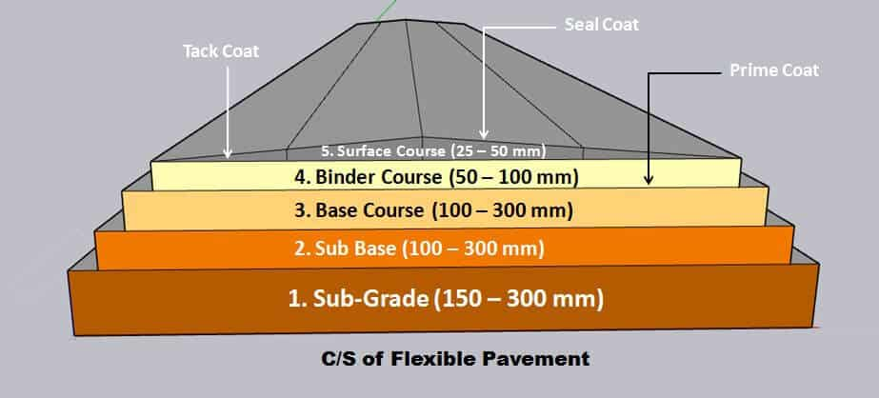
Findings :-
From the table we found that, we can use quarry wastes and crushed glass as a replacement of sand and use them as fillers.
We can use the reclaimed asphalt in the road construction as it has strong impact value.
We can use the waste concrete in the bituminous concrete surface course.
We can use the iron slags in the road construction as it has exceptionally strong impact value.
We can mix the waste plastic bottles with bituminous and use it in a replacement of bituminous in road construction.

Slide 43
Road Map
Application Of Recycled Materials In Road Construction
Materials Collection
Tests Performed
Conclusion & Future Scope
Mix Design & Marshall Stability test to be perfomed
Comparison

Slide 44
THANK YOU

